Slide 1
Advancing aviation, keeping the skies safe.
July 2019

Slide 2
The Content Carousel
Who
Our businesses
What we do
Our certifications
What
UK upper airspace
Airport services
International business
Why
Product and service offerings
Advancing aviation, keeping the skies safe
Our operation
Performance
People

Slide 3
Our Businesses
The NATS group provides air traffic control services through two principle operating subsidiaries, NATS en route plc (NERL) and NATS Services (NSL).
Both are subject to safety regulation by the UK Civil Aviation Authority.
NATS en route (NERL)
• Operates under license issued by the UK Government to manage UK upper airspace
• Subject to economic regulation on prices and revenues by the UK Civil Aviation Authority

Slide 4
Our Businesses
NATS Services
• An unregulated business
• Competing in the commercial marketplace
• Provides ATC services to airports, and aviation related services to UK and International businesses
• Customers include the UK Ministry of Defence, Governments, airports, airlines, wind farms and other airspace users
• Supporting customers in over 30 countries across the globe with a key presence in Europe, the Middle East and Asia Pacific

Slide 5
What we do
Operation of Control Centres to manage UK airspace
A leading member of initiatives and alliances
Provide air traffic control services at airport towers
Provide aviation services to Airlines, ANSPs, Governments and the Military in over 30 countries
Notes:
SESAR: The first three letters stand for Single European Sky and the last stand for Air Traffic Management (ATM) Research. In its broadest context, SESAR aims to coordinate and create a high performance pan-European ATM modernisation System to support the aviation industry to be sustainable for the future whilst remaining safe.
FAB (functional airspace blocks): The UK/Irish FAB started in June 2008 and was the first FAB in the EU. It is estimated that the benefits to be realised from the FAB projects which enable shorter track distances, reduced fuel burn and less CO2 emissions will lead to some €35m of cost savings to airline customers each year.
A6 Alliance: The A6 Alliance is an inclusive coalition of ANSPs committed to the modernisation of the European ATM system. The Alliance seeks to maximise synergies between the ANSP members to deliver customer and network benefits; and to provide leadership at a European level in critical technical and strategic areas.
Borealis: The Borealis Alliance is a leading Alliance of Air Navigation Service Providers (ANSPs) that enables its Members to drive better performance for stakeholders through business collaboration. The Borealis Alliance is currently working on a major programme to deliver free route airspace across the whole of Northern Europe by 2020. The programme will create free route airspace extending from the eastern boundary of the North Atlantic to the western boundary of Russian airspace in the North of Europe, delivering significant customer benefits in terms of fuel efficiency, environmental performance and cost savings.

Slide 6
Our ISO Certifications
ISO 9001: 2015
ISO 14001
ISO 31000
ISO 27001
Certified for all activities including the planning, design, training, management and operation of Air Traffic Management, Air Traffic Engineering and Aeronautical Information Management services
Environmental Management System
Risk Management Standard
Information Security Management

Slide 7
Management of UK Airspace
In UK airspace we handle
2.54 million flights. 1.2% more than 2018
Over 250 million passengers
Watch our Value of UK Airspace video

Slide 8
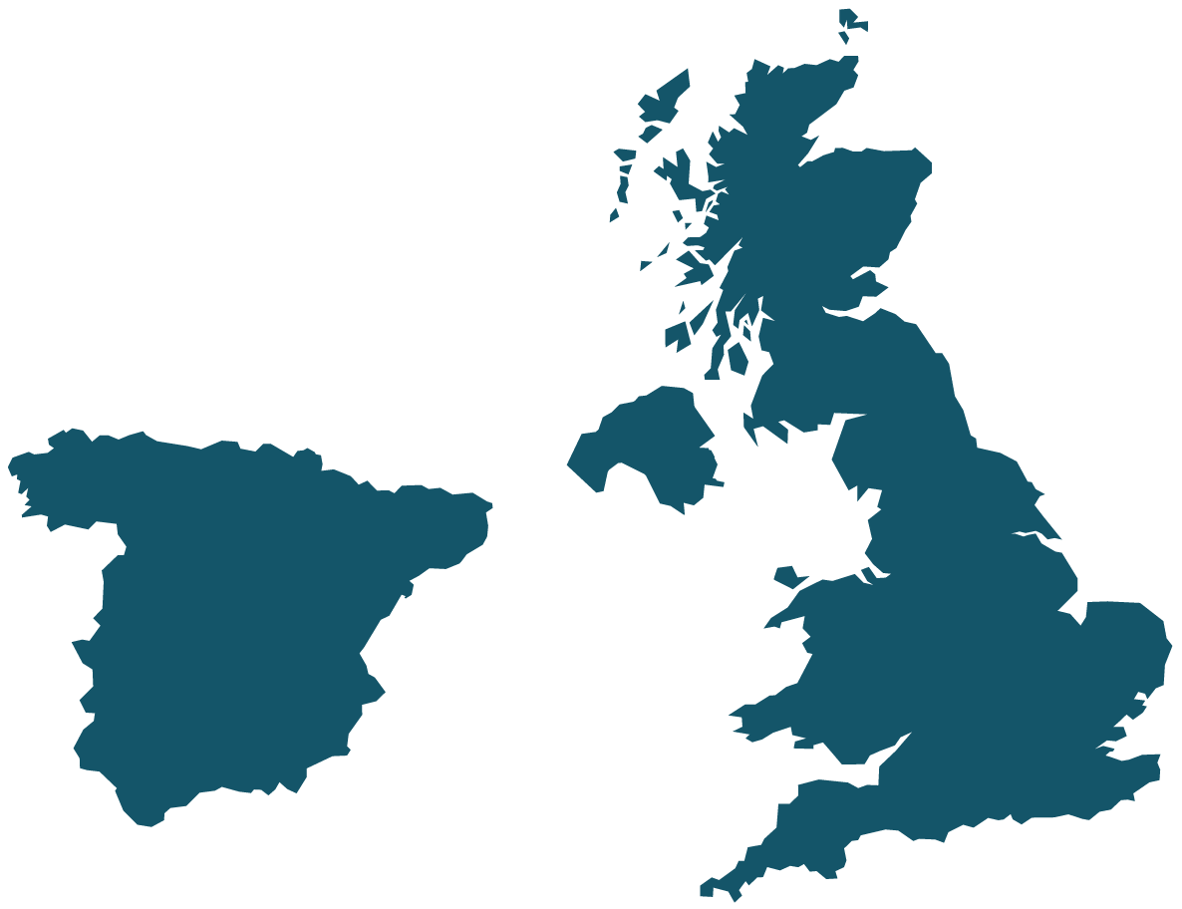
ATC Service Locations
We provide ATC services to 13 UK Towers, Gibraltar and in Spain as part of a joint venture with Ferrovial
ABERDEEN
GLASGOW
Operated by NATS
Operated by FerroNATS
Andorra-LA SEU d’urgell
BELFAST INTERNATIONAL
A Coruña
BELFAST CITY
Operated by Aquila
VIGO
Lleida-alguaire
SABADELL
MANCHESTER
Madrid
Cuatro Vientos
VALENCIA
ALICANTE
IBIZA
LUTON
STANSTED
CÓRDOBA
LONDON CITY
SEVILLA
murcia
CARDIFF
HEATHROW
JEREZ
BRISTOL
Farnborough
GIBRALTAR
SOUTHAMPTON
8
Notes:
Aquila – This is a joint venture between NATS and Thales to deliver Project Marshall. Marshall seeks to ensure a safe, efficient and sustainable Air Traffic Management (ATM) service for the UK Armed Forces through modernising over 100 MOD locations in the UK and overseas.

Slide 9
International Air Traffic Management
Europe
We are working in our domestic UK market and with European customers to improve the efficiency of trans-European air traffic and apply common EU standards.
Middle East
NATS is supporting rapid growth in the Middle East as the region develops into one of the worlds most important aviation hubs.
Asia Pacific
NATS is helping to enable the exponential growth of air travel in the Asia Pacific region, helping to ensure this expansion takes place in a planned and sustainable manner.
9

Slide 10
Services to maintain and grow airport operations
Providing solutions to runway throughput, congestion and unexpected disruption
Digital towers
Engineering services
Intelligent approach including Enhanced Time Based Separation (eTBS) and RECAT
Training and real time simulation
Notes:
Digital Towers: The advent of super-fast fibre networks, high definition cameras and remote sensing technology is allowing for a revolution in airport air traffic management. Instead of a tower full of controllers and equipment, there is a camera mast that transmits images and data to a separate control centre in a remote location. This transmission provides a live panoramic feed that can be augmented with other operational data, from radar labels on individual aircraft, to the location of closed taxiways.
NATS have partnered with NAV CANADA taking an equal shareholding in the Canadian digital tower firm, Searidge Technologies to provide the solutions. Since the joint venture in 2017, NATS have won contracts to create a Virtual Control Room contingency system for Heathrow airport, a smart prototype for Changi airport and to build and operate a live digital air traffic control tower for London City in 2019 – the first in the UK.
Intelligent Approach
Intelligent Approach along with TBS help contribute to variable spacing. This means that we can
Dynamically adjust the separation between arrivals, maintaining the time separation between aircraft at a constant equivalent to the distance separation required in a headwind of 5-7 knots. This will be further improved with the introduction of enhanced TBS in Spring 2018 which introduces RECAT EU wake vortex categories and will slightly increase tactical landing capacity.

Slide 11
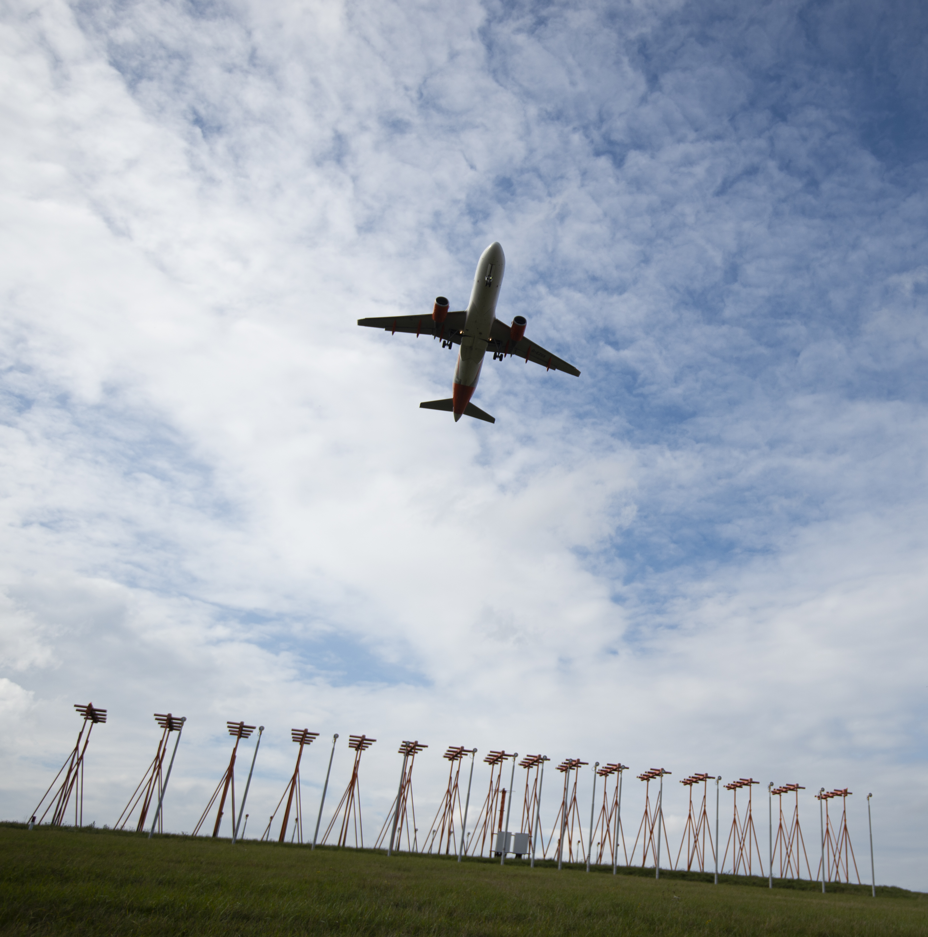
Creating efficiency through data
The intelligent use of data can create capacity and efficiency. This is a key area for which NATS provides services to airports and airlines, and includes;
• Airport Capacity Enhancement (ACE)
• Aeronautical Information Management (AIM)
Notes:
ACE - ACE is a scalable solution that comprises a suite of services and products that enables us to expedite positive change to enhance performance, capacity, resilience, punctuality and passenger experience whilst maximising the use of existing airfield infrastructure and assets.
AIM - AIM is an automated digital solution developed by NATS to allow Air Navigation Service Providers to update and share data such as terrain and obstacle, flight procedures and airport and charts. This system reduces data entry errors and increases efficiency by converting raw data to useable information.

Slide 12
Airspace performance
Creating a safe and efficient airspace to meet the growing demands of ever busier skies.
UK Drone Assist App
iFACTS and iTEC systems for controllers
XMAN and Free Route Airspace to optimise flight efficiency
Notes:
iFACTS:
The system uses the current position of the aircraft, the flight plan and complex mathematics to predict the likely future position of all the aircraft in a sector. These positions are then compared for up to 18 minutes into the future and any potential conflicts are highlighted to the controller.
iTEC:
‘interoperability Through European Collaboration’, will eventually allow air traffic controllers to share data across national borders and use it to plot detailed trajectories for aircraft before they reach UK airspace, increasing safety and capacity yet reducing fuel burn and emissions.
By pulling together a range of tools that both reduce air traffic controllers’ workload and improve safety by automatically detecting potential aircraft conflicts ahead of time, we believe the iTEC control system has the potential to increase airspace capacity by as much as 40 per cent, without compromising safety.
XMAN:
A new operational procedure to cut the amount of time aircraft circle in ‘holding stacks’ at London Heathrow Airport began on 1st April.
Traditionally NATS has only been able to influence an arriving aircraft’s approach to Heathrow once it enters UK airspace – sometimes only 80 miles from the airport. This limits the opportunity to manage the flow of traffic and can result in additional time spent in the holding stacks.
As part of the Cross Border Arrival Management (XMAN) trial, if delays in the Heathrow holding stacks begin to build, air traffic controllers in the Netherlands, France, Scotland and Ireland will be asked to slow down aircraft up to 350 miles away from London to help minimise delays on arrival.
Free Route Airspace:
A specified airspace within which users may freely plan a route between a defined entry point and a defined exit point, with the possibility to route via intermediate (published or unpublished) waypoints, without reference to the ATS route network, subject to airspace availability. Within this airspace, flights remain subject to air traffic control.

Slide 13
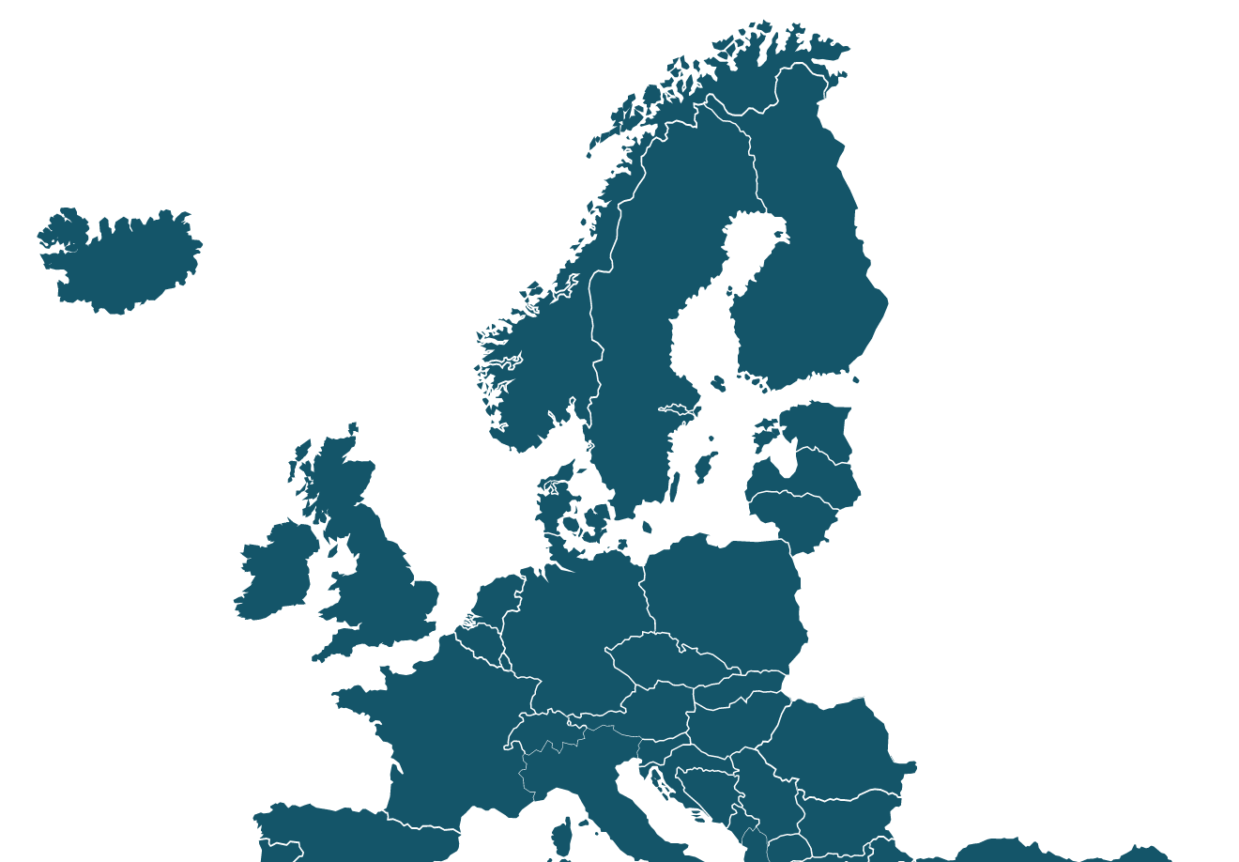
Our airspace
Flight Information Regions
London & Scottish FIRs:
1m km² – 11% of Europe’s airspace and 25% of traffic
Shanwick Oceanic Control Area
Scottish FIR
Shanwick
2.2m km² – 80% of North Atlantic traffic
London FIR
13

Slide 14
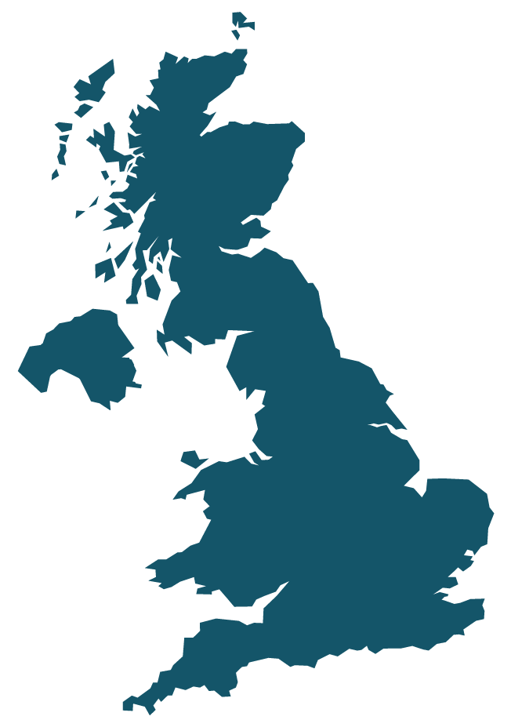
Our centres
En route locations
Swanwick Centre
Handles on average 5,500 flights/day
Prestwick Centre
Handles on average 3,400 flights/day
PRESTWICK CENTRE
– London Area Control Centre
– London Terminal Control Centre
– London Military Air Traffic Control
– Scottish Oceanic Control Centre
– Scottish Area Control Centre
– Manchester Area Control Centre
Whiteley
Head office
– College and Training centre – Engineering – AQUILA – Support functions
SWANWICK CENTRE
WHITELEY (HEAD OFFICE)
14
Notes:
Scottish Oceanic Control = controls the airspace over the eastern half of the North Atlantic from the Azores (45 degrees north) to a boundary with Iceland (61 degrees north).
The Scottish Area Control Centre (ScACC), which controls aircraft over Scotland, Northern Ireland, Northern England and the North Sea from 2,500 feet up to 66,000 feet.
The Manchester Area Control Centre (MACC), which controls aircraft over much of the north of England, the Midlands and north Wales from 2,500 feet up to 28,500 feet.
The London Area Control Centre (LACC) which manages en route traffic in the London Flight Information Region. This includes en route airspace over England and Wales up to the Scottish border.
The London Terminal Control Centre (LTCC) which handles traffic below 24,500 feet flying to or from London’s airports. This area, one of the busiest in Europe, extends south and east to the borders of France and the Netherlands, west towards Bristol and north to near Birmingham.
Military Air Traffic Control which provides services to military aircraft (and civil aircraft when required) operating outside of controlled airspace. They work closely with civilian controllers to ensure the safe co-ordination of traffic.

Slide 15
Our operational and environment performance
 | PPP year | CP2 |  |  |  | CP3 |  |  |  | RP2
 | 01/02 | 07/08 | 08/09 | 09/10 | 10/11 | 11/12 | 12/13 | 13/14 | 14/15 | 15/16 | 16/17 | 17/18 | 18/19
Traffic (flight millions) | 2.001 | 2.480 | 2.372 | 2.172 | 2.116 | 2.167 | 2.126 | 2.162 | 2.216 | 2.278 | 2.45 | 2.515 | 2.544
Safety (airprox) Risk bearing (Cat A/B) | 8 | 2 | 0 | 0 | 0 | 0 | 0 | 1 | 1 | 0 | 0 | 0 | 0
Delay seconds NERL attributable (seconds) | 109.4 | 26.8 | 19.3 | 4.3 | 4.3 | 7.3 | 1.4 | 5.5 | 2.4 | 4.3 | 10.9 | 7.2 | 11.5
CO2 emissions savings (tonnes) |  | 16,488 | 35,552 | 82,880 | 40,848 | 134,131 | 83,028 | 86,617 | 481,802 | 157,156 | 59,768 | 273,600 | 113,700
Headcount (average) | 5,652 | 5,158 | 5,084 | 4,920 | 4,652 | 4,533 | 4,562 | 4,519 | 4,342 | 4,196 | 4,216 | 4,310 | 4,464
Group profit/(loss) before tax (£m) | (79.9) | 66.7 | 135.5 | 78.3 | 106.1 | 194.5 | 160.8 | 157.5 | 200.3 | 44.4 | 125.5 | 132.8 | 98.2

Slide 16
Our firsts
Establishing the UK’s first digital remote tower for London City Airport
World’s first ANSP to publicly release a flight tracking app which uses radar data to display aircraft positions
Commenced operational trials with space-based ADS-B in Oceanic operations
In 1992 became the world’s first ANSP to develop and adopt formal safety procedures
Created the world’s first virtual control facility with full SRG certification at Heathrow
16

Slide 17
Highlights of 18/19
Responded to RP3 (2020-2024) National Performance Plan proposals
and continue to deploy new ATC equipment and software to modernise airspace
Deployed electronic flight strips
into the Terminal Control (TC) operation in a phased transition which completed in June 2018
Strengthened contracts
including winning a 10 year contract at Cardiff and St Athan’s airports
Acquired a strategic minority interest in Aireon
a satellite-based air traffic surveillance system with global coverage capable of tracking and monitoring aircraft in real-time

Slide 18
Our people
c.4,464
1782
1133
892
657
Current NATS employees
Air Traffic Controllers
Others
Engineers
Air Traffic Service Assistants

Slide 19
Awards from industry organisations

Slide 20
Our executive
Martin Rolfe
Chief Executive Officer
Guy
Adams
Commercial Director
Alistair
Borthwick
Finance Director
Richard Churchill-Coleman
Legal Director
Julie Elder
HR and Corporate Service Director
Juliet Kennedy
Operations Director
Alastair Muir
Safety Director
Simon Warr
Communications Director
Rob Watkins
Technical Services Director
20

Slide 21
Our structure
49.9%
16.68%
13.18%
13.18%
2.04%
2.04%
1.8%
1.17%
Government
49%
Airline Group
42%
Heathrow Airport Holdings Ltd 4%
Employees 5%
European Commission
NSL NATS Service Ltd
Revenue
FY18/19: £885.7m
Employees
4464c
CAA
NERL NATS (En route) plc
Economic Regulation
21

Slide 22
Thank you

